Slide 1

Primary 1 Transition
Moving on to P2!

Slide 2
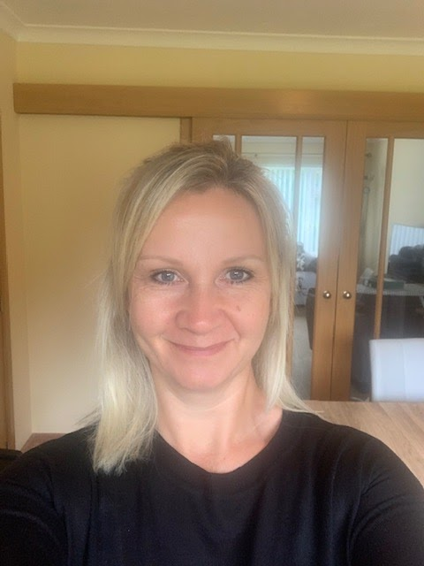
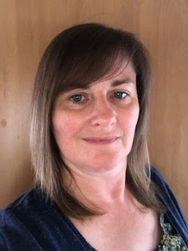
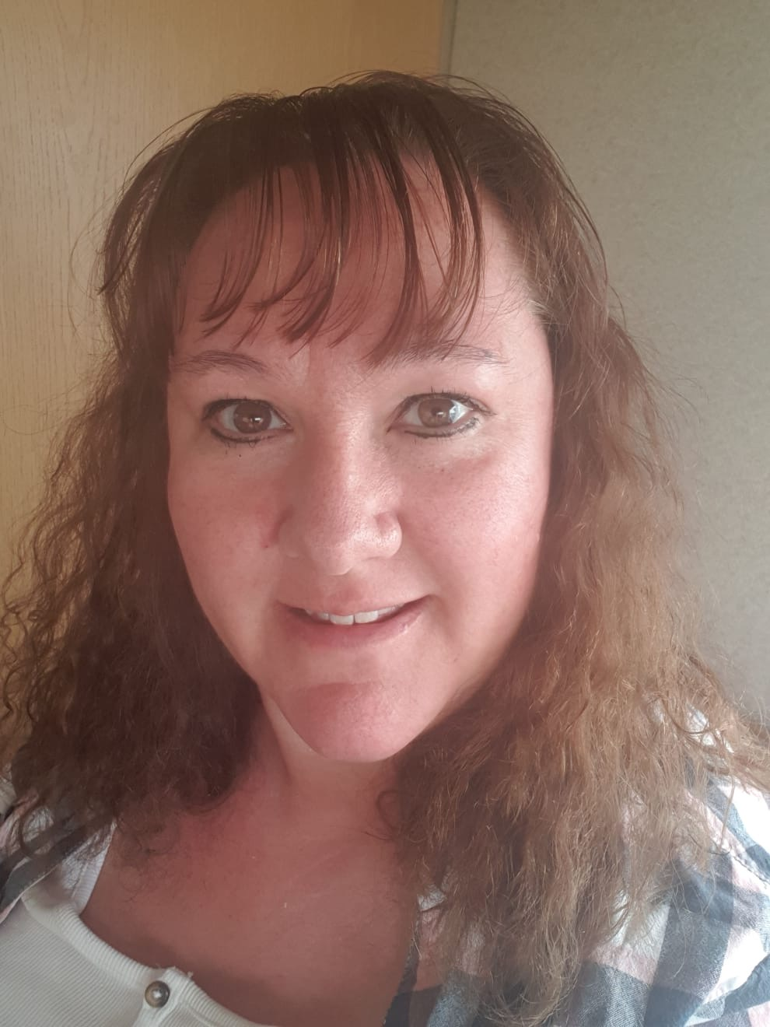
Primary 1 - you are an incredible year group and we have LOVED being your teachers this year!

Slide 3
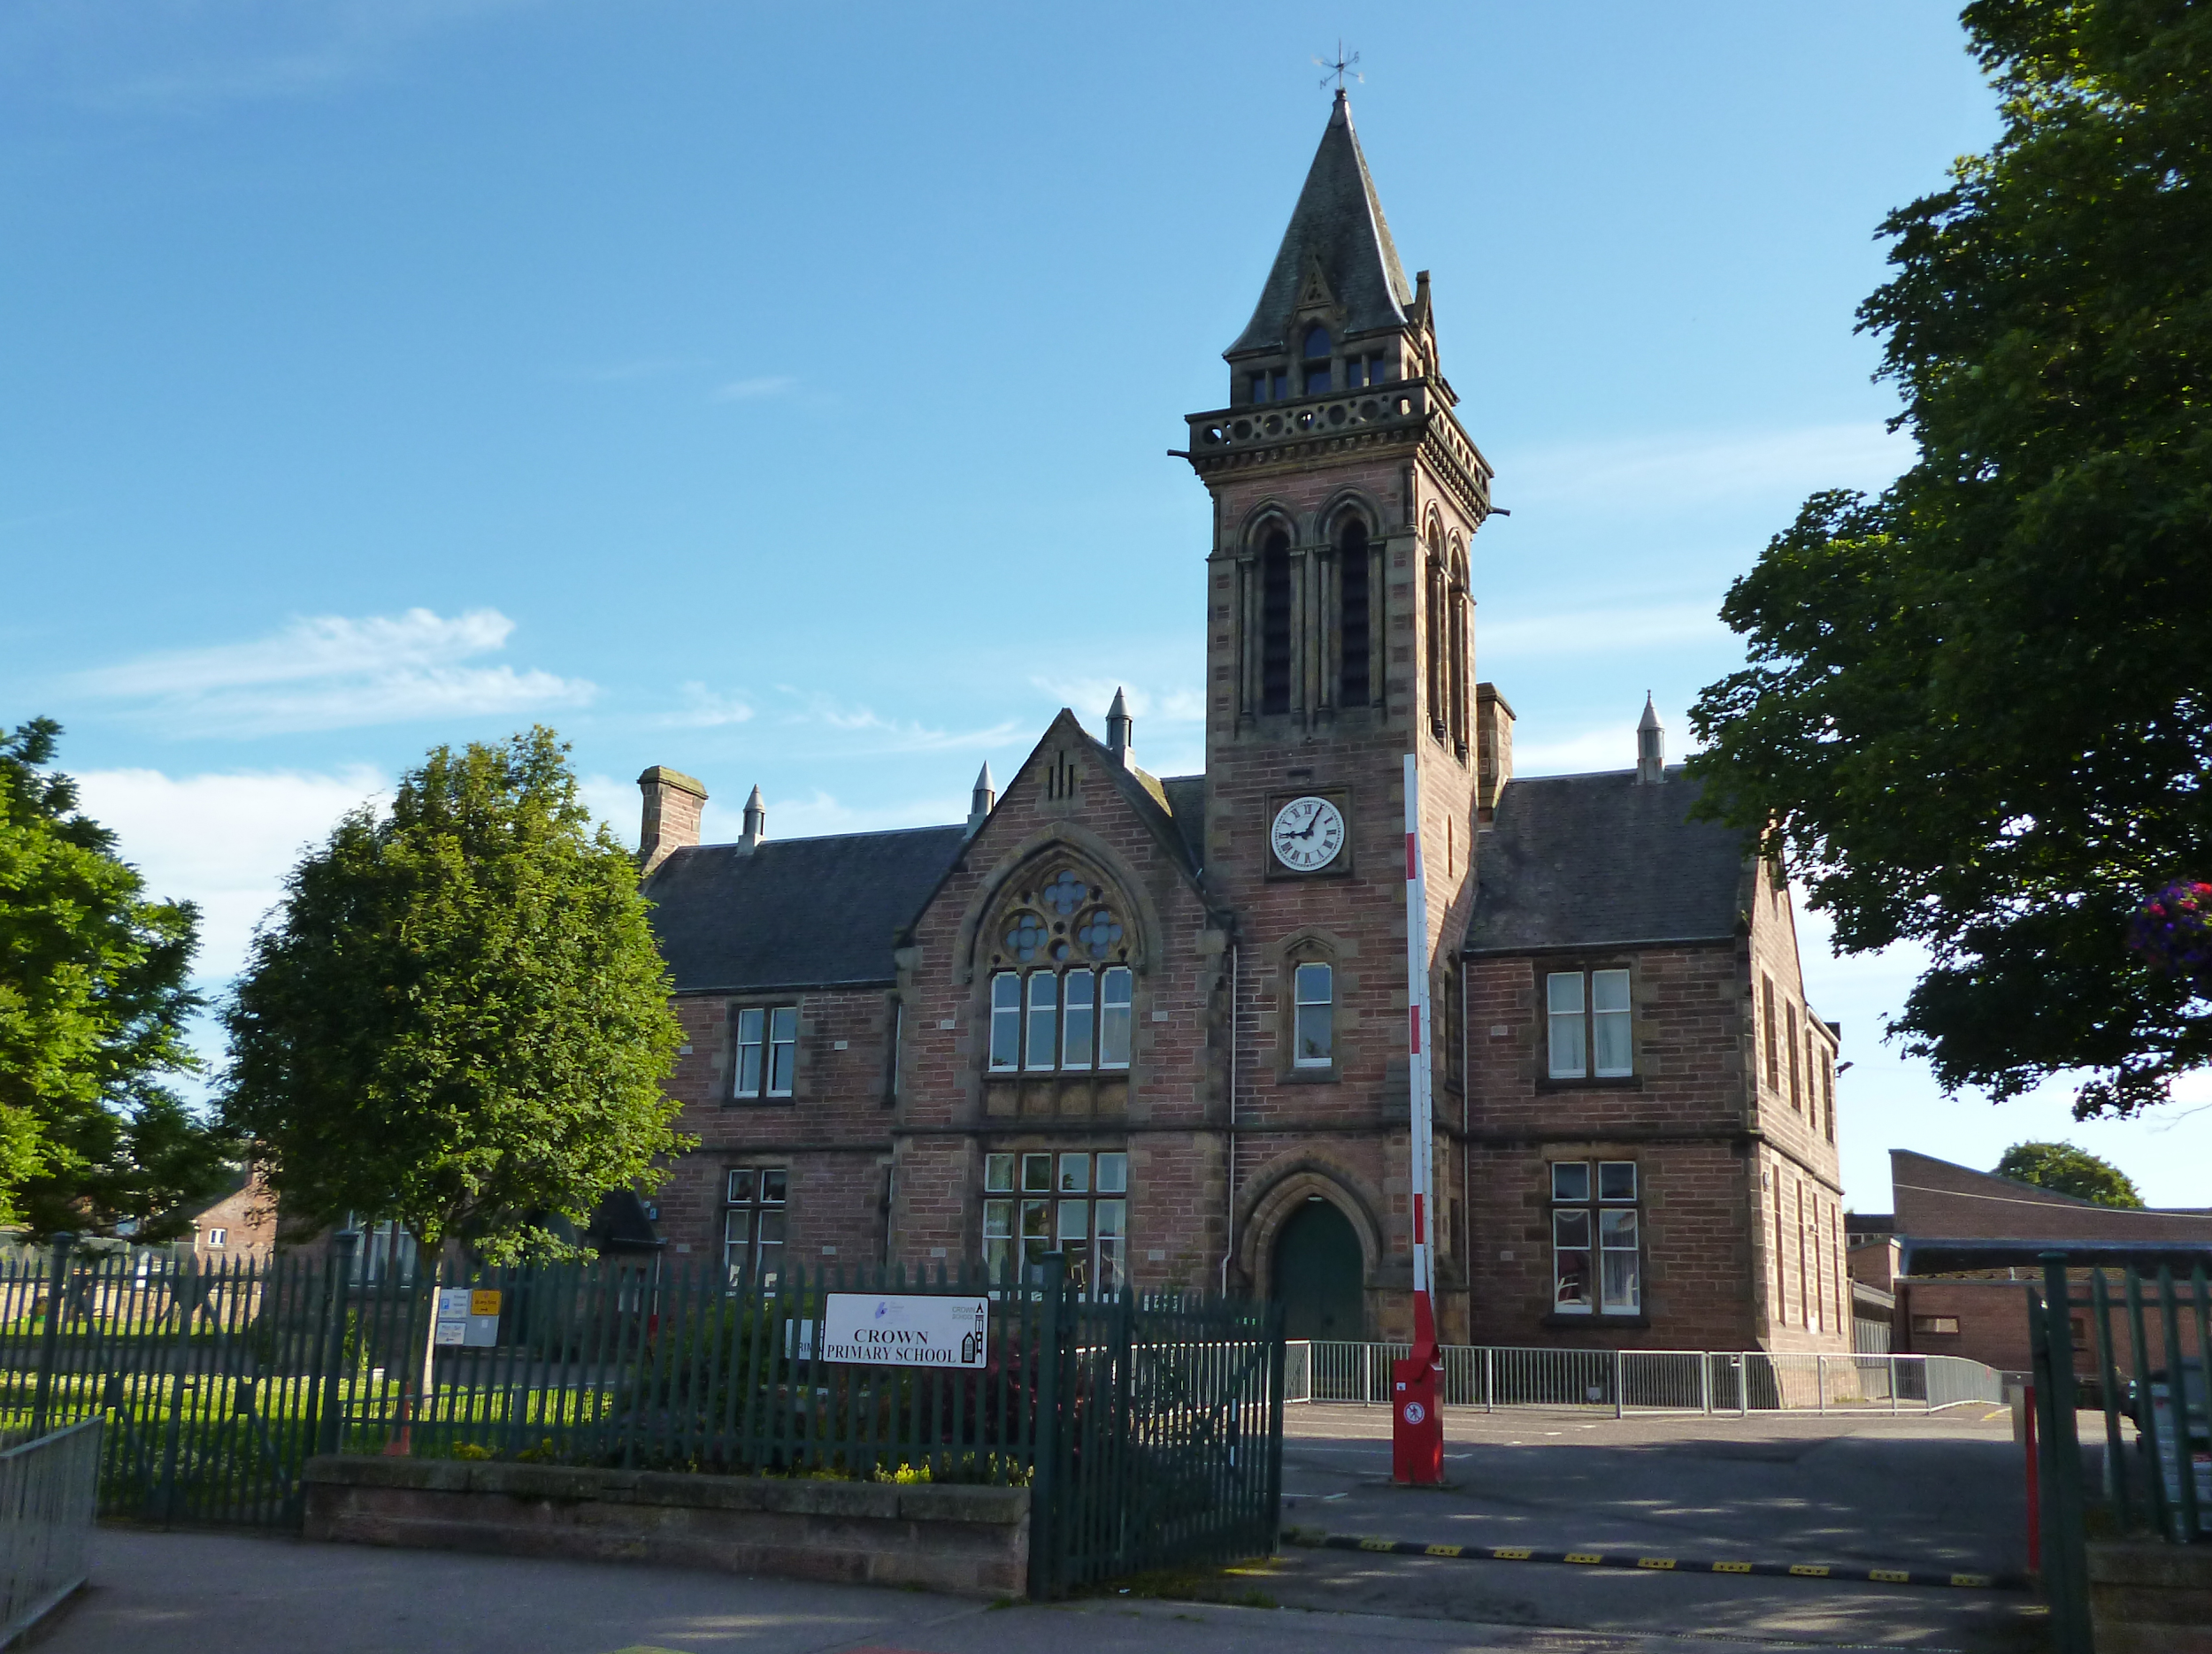

We were sad that our time in the physical school building was cut short, but you have made us feel happy and extremely proud by being kind and caring and working really hard with your online learning.

Slide 4
This time of year always feels a bit strange, as we think about moving on from one class to another.
It may also feel a little trickier this year due to the current circumstances with Covid-19 and lockdown. It may feel totally ok.
Whatever you are feeling just now, it is ok to be feeling that way. You might be feeling many emotions - that’s ok too!
Read the poem, ‘Moving On’ on the next slide.

Slide 5



Moving On
Time is flying quickly and you are growing fast,
I can’t believe this year has gone and now is in the past.
We’ve had so many lovely times; with fun along the way,
Your smile has always cheered me up on each and every day.
So remember you’re fantastic; a little shining star,
Go forward and just be yourself, just perfect as you are!

Slide 6
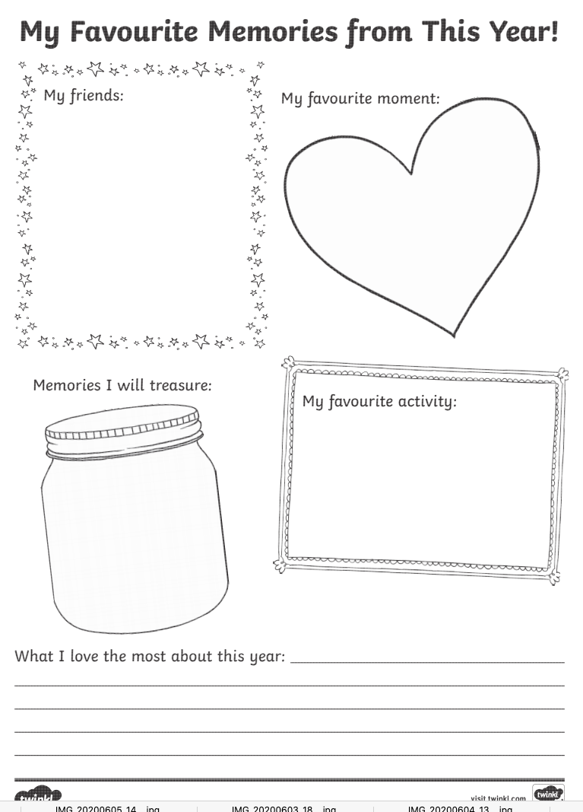
Before we move on we want you to think about what your Primary 1 has meant for you.
Click here to get the link to download this sheet.
Don’t worry if you do not have a printer, just use a piece of paper to record your thoughts.
Take a photo and post it onto the classroom but keep this piece of work safe as you can stick it into your Pupil Profile when we get back to school.

Slide 7
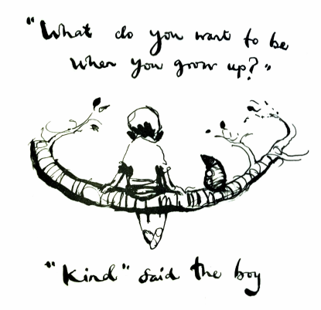
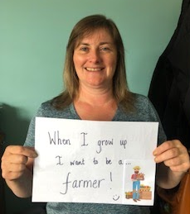
What would you like to be when you grow up?
Make a sign to hold up saying what you would like to be.
I would like to be...
Take a photo and post it on the classroom.

Slide 8

Moving on to P2!
Making your mark on your new learning space!
Take a photo of yourself or draw a picture with a lovely big smile (then take a photo)!
Insert your photo to the assigned google doc (blank page). Your photo can be uploaded by using the insert tab: choose insert image, choose upload from computer, click/select the picture you wish to insert. Your picture should be put into the document.
Type your name in large font, pick any colour and design you wish. Put your name and your photo at the bottom of the page. We will print and fold in half to create a desk sign.
Hand in/Turn in this assigned google doc.
These will be placed in your new learning space when you return in August.
Mrs Fowler

Slide 9

So, enjoy your summer holidays and get some well-earned rest,
To start the new year full of beans; prepared to try your best.
Your next teacher’s the lucky one - I’m certain this is true,
Because they get to teach and spend the time next year with you.
Next week we will not be planning for literacy and numeracy BUT we will be celebrating our time in Primary 1 and thinking more about moving into Primary 2 so we have one or two little ‘meet’ parties for you to join in with. We will post more details next week and hope to see you if you are free.

